Slide 1
Type Checking

Slide 2
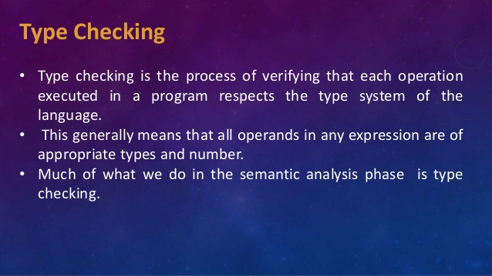
Type Checking

Slide 3
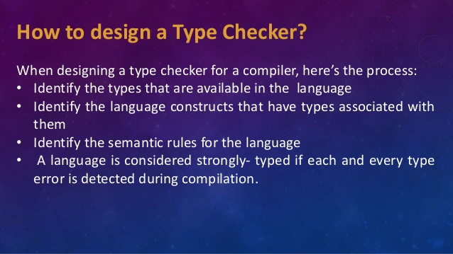

Slide 4
Function of Type Checker
A type checker verifies that the type of a construct matches that expected by its context.
Type checking uses logical rules to reason about the behavior of a program at run time.
Specifically, it ensures that the types of the operands match the type expected by an operator.
For example, the && operator in Java expects its two operands to be Booleans; the result is also of type Boolean.
Syntax
tree
Syntax
tree
Parser
Type Checker
I code generator
3 address
code
token

Slide 5
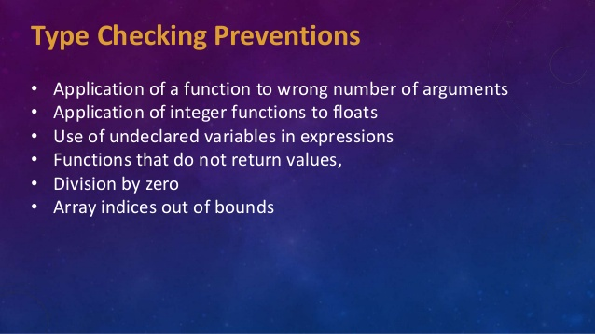

Slide 6
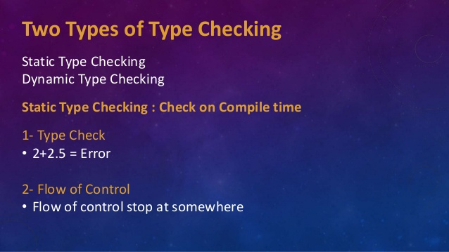

Slide 7
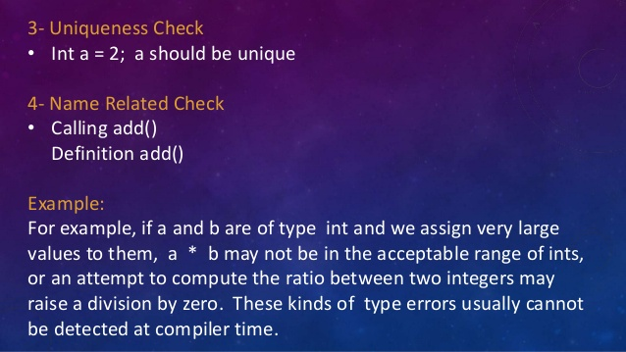

Slide 8
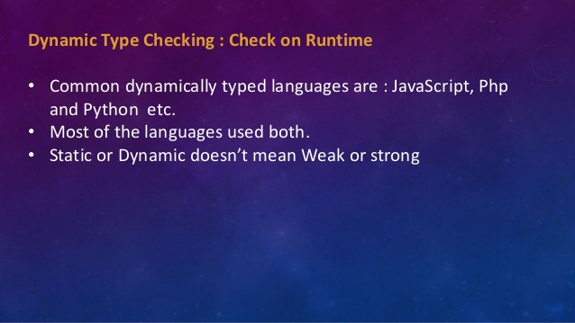

Slide 9
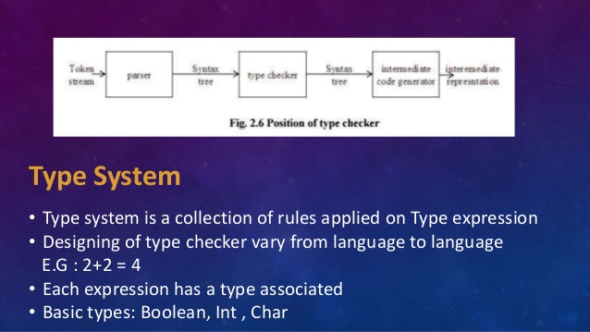

Slide 10
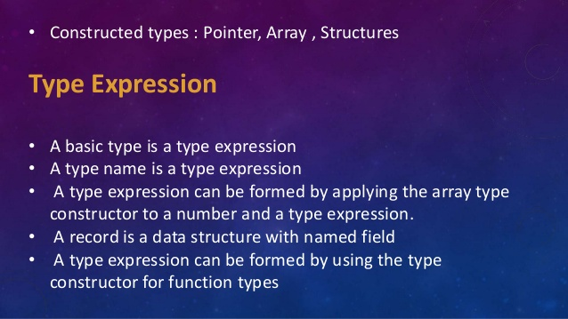

Slide 11
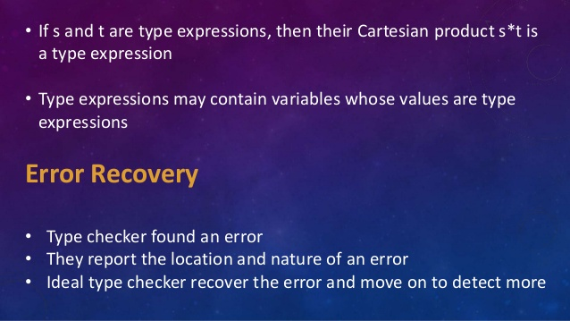

Slide 12
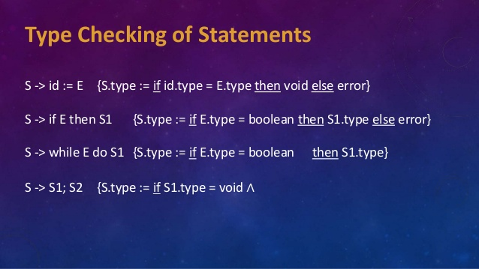

Slide 13
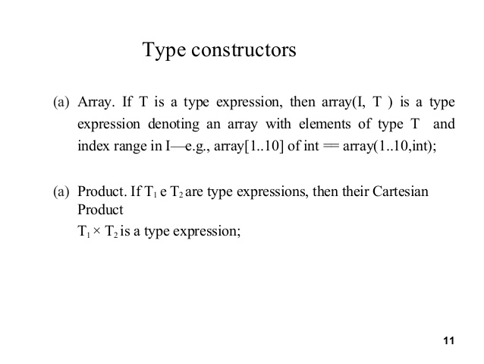

Slide 14
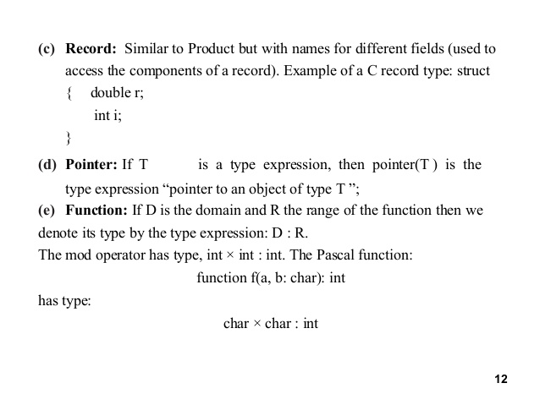

Slide 15
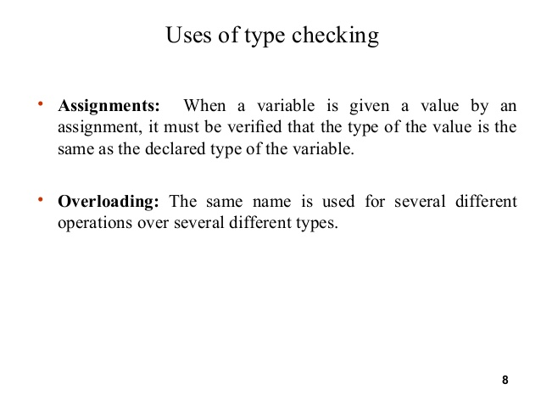

Slide 16
